Slide 1
Database Management System (KCS 501)
Day 1

Slide 2
General Guideline
© (2021) ABES Engineering College.
This document contains valuable confidential and proprietary information of ABESEC. Such confidential and proprietary information includes, amongst others, proprietary intellectual property which can be legally protected and commercialized. Such information is furnished herein for training purposes only. Except with the express prior written permission of ABESEC, this document and the information contained herein may not be published, disclosed, or used for any other purpose.

Slide 3
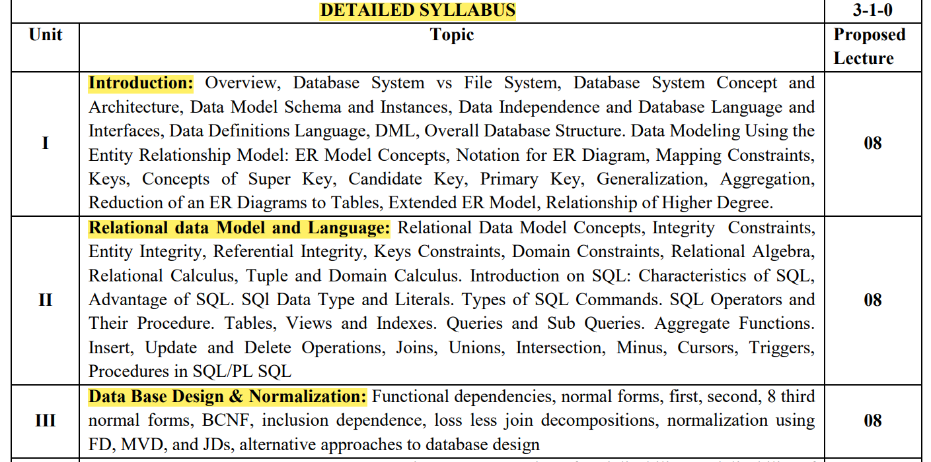
University Syllabus (AKTU)

Slide 4
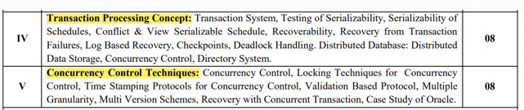
University Syllabus (AKTU)

Slide 5
Course Outcomes (As per AKTU)

Slide 6
Course Objectives
To understand the role of a database management system in an organisation.
Understand basic database concepts, including the structure and operation of the relational data model.
Construct simple and moderately advanced database queries using Structured Query Language (SQL).
Understand and successfully apply logical database design principles, including E-R diagrams and database normalization.
Understand the concept of a database transaction and related database facilities, including concurrency control, journaling, backup and recovery, and data object locking and protocols.
Understand the role of the database administrator.

Slide 7
Modules to be covered
S. No. | Module Name
1 | Introduction
2 | Entity Relationship Model
3 | Relation Data Model
4 | Database Language
5 | Database Design
S. No. | Module Name
6 | Normalization
7. | Transaction System
8. | Recovery
9. | Concurrency Control
10 | Advance Concept in DBMS

Slide 8
Lecture Delivery Schedule
Program | Sem | Course | Course Code | Periods (University) |  |  | Evaluation Scheme |  |  |  | Course | Credit
 |  | Name |  | L | T | P | Sessional Marks |  |  | UE | Total
 |  |  |  |  |  |  | CT | TA | Total
B.Tech (CSE/CS/IT) | V | Database Management System | KCS501 | 3 | 1 | 2 | 30 | 20 | 50 | 100 | 150 | 4
Periods (Actual) |  |  | Name of Faculty | Vertical Head | Date of | Total lectures planned | Date of Conclusion
L | T | P |  |  | Commencement
4 | 0 | 4 | Mr. Deepak Aneja |  | 11.09.2023 | 48

Slide 9
Assignments / Assessments & Sessional Test
Sessional Test 1
Sessional Test 2
Sessional Test 3
Best 2 will be considered
CT (30 Marks): ST1(12.5)+ ST2(12.5) =Total 25 + 5 Marks (10 Quizs: 2Quiz from each Unit)
TA (20 Marks): 10 Marks (Attendance) + 10 Marks (Assignment/ Class Test)
Attendance: Above 85%: 10 Marks
75% to 84.99 : 9 Marks
Less Than 75: 8 Marks

Slide 10
Lab Plan
..\DBMS lab Delivery 2022-23 ODD sem.xls

Slide 11
Text and Reference Books, other resources
Book | Author
Database Concepts | Korth, Silbertz, Sudarshan
An Introduction to Database System | Date CJ
Fundamental of Database System | Elmasri , Navathe
Databases | O’Neil
Database Management System | Ramakrishnan
Database Management System | Leon & Leon
An Introduction to Database System | Bipin C Desai
Database Management System | Majumdar & Bhattacharya

Slide 12
Importance of Database Management System
Helps organization in managing different databases and retrieving relevant information.
The ability to access data efficiently allows companies to make informed decisions quicker.
Database can be accessed on computers, tablets, and even mobile devices.
It allows users to perform multiple task with ease.
It ensure better enforcement data privacy and security policies.

Slide 13






Companies ….

Slide 14
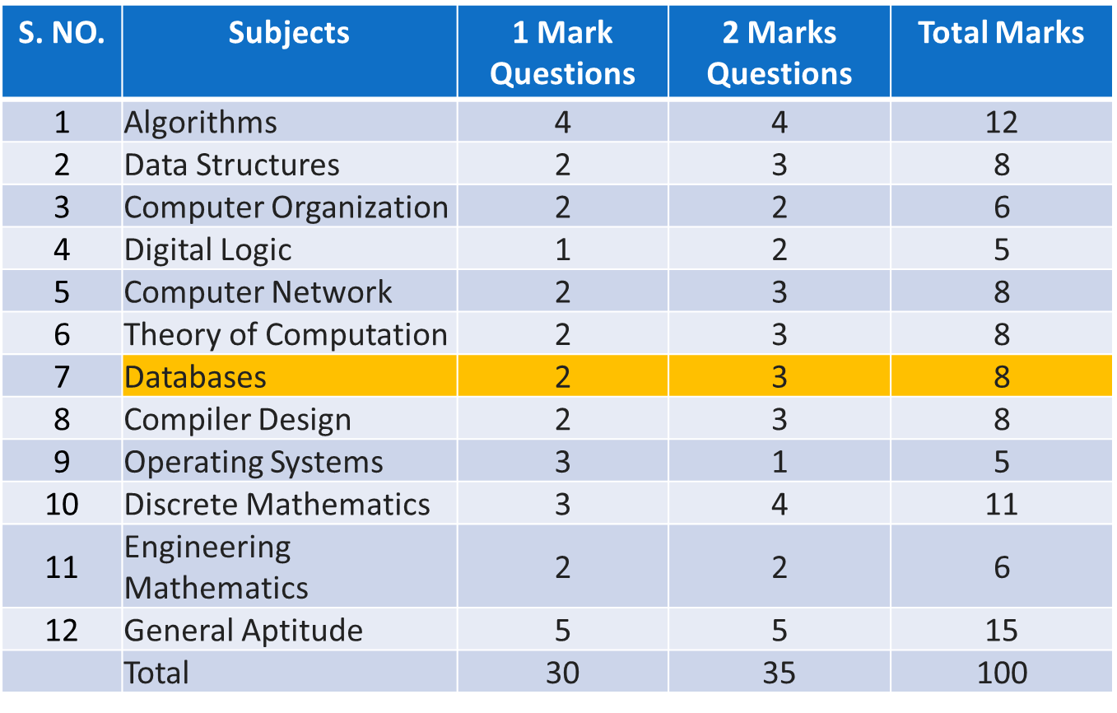
GATE 2021 CS & IT Paper – Subject wise Analysis

Slide 15
Data ??
Data are the facts that can be recorded in the form of texts, numbers, videos, audio, or images.
For example: - Roll number, student name, course name, branch name, date of birth, admission date are the facts about a student.

Slide 16
References
https://aktu.ac.in/syllabus%202020-2021.html
https://www.mcg.dk/post/what-is-the-importance-of-a-database-management-system

Slide 17
Thank You

